Slide 1

Spatial Computing
By Vijay Rangaswamy

Slide 2

Understanding Spatial Computing

Slide 3
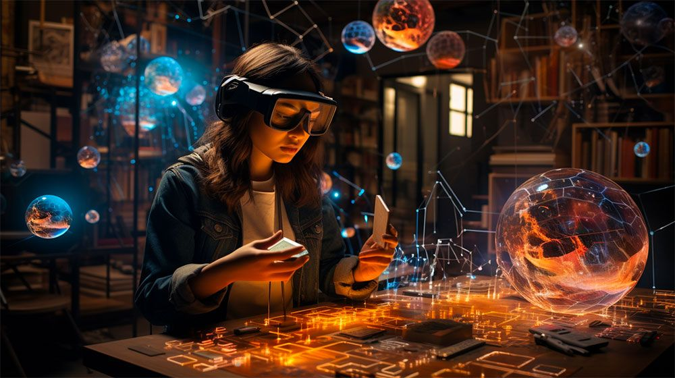
An Introduction
Spatial computing broadly characterizes the processes and tools used to capture, process and interact with three-dimensional (3D) data.
Spatial computing is a technology defined by computers blending data from the world around them in a natural way.
It shifts the focus from teaching people to interact with computers in digital environments to teaching computers to better understand and interact with people naturally in the human world.

Slide 4
Continuation
Spatial computing mirrors how we interact with virtual objects in the real world. Humans translate the two-dimensional images that they see into a 3D model of the world, make sense of objects in the world and then direct their hands to act.
For example, when we pour a cup of tea, we watch the cup as we pour, determine when the cup is full and then stop pouring. Spatial computing does the same but with computers and sensors.

Slide 5
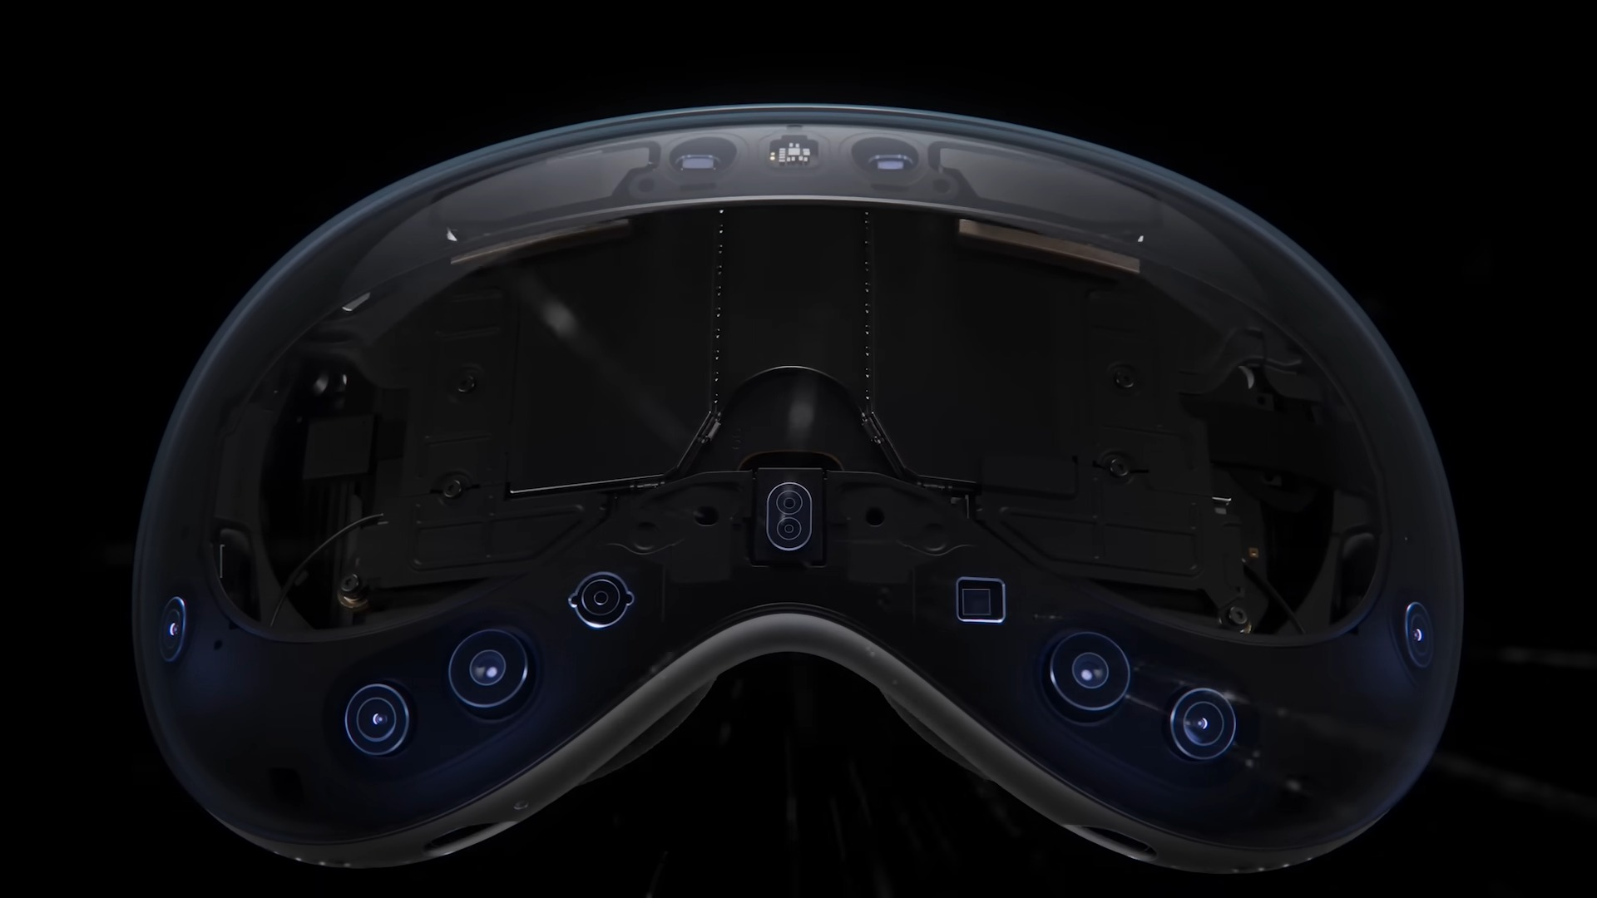
How Does It Work?

Slide 6
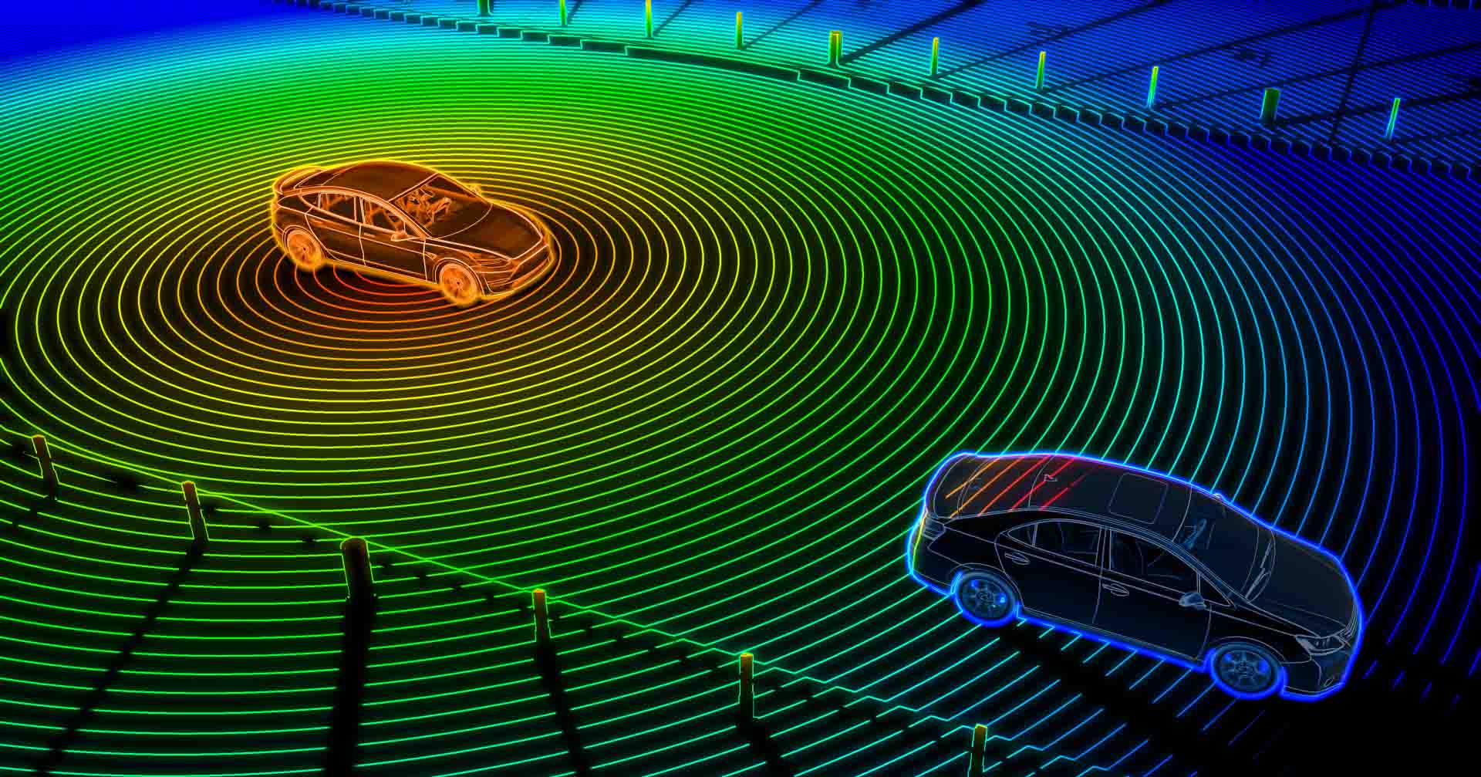
Steps Involved
Gather data: Spatial mapping techniques are used to gather data around the user and the device's surroundings.
Techniques such as photogrammetry, lidar and radar capture a 3D model of the world. Lidar or radar measure the reflection of a laser or radio signal off objects around a scanner to automatically capture a point cloud, which are sets of data points in a space that represent 3D shapes and distances. Photogrammetry, described as the art and science of creating 3D models from photographs, combines imagery from multiple images or cameras.
Newer AI techniques can also capture a richer representation using a handful of images.

Slide 7
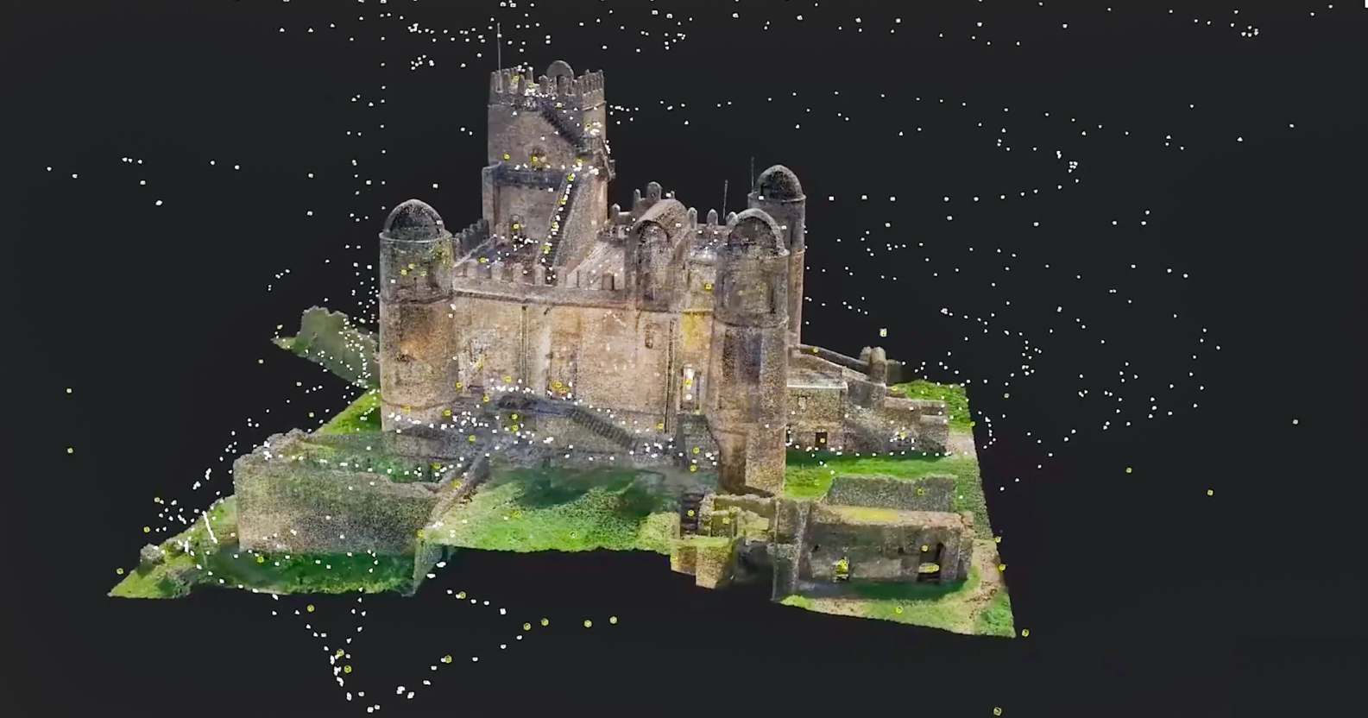
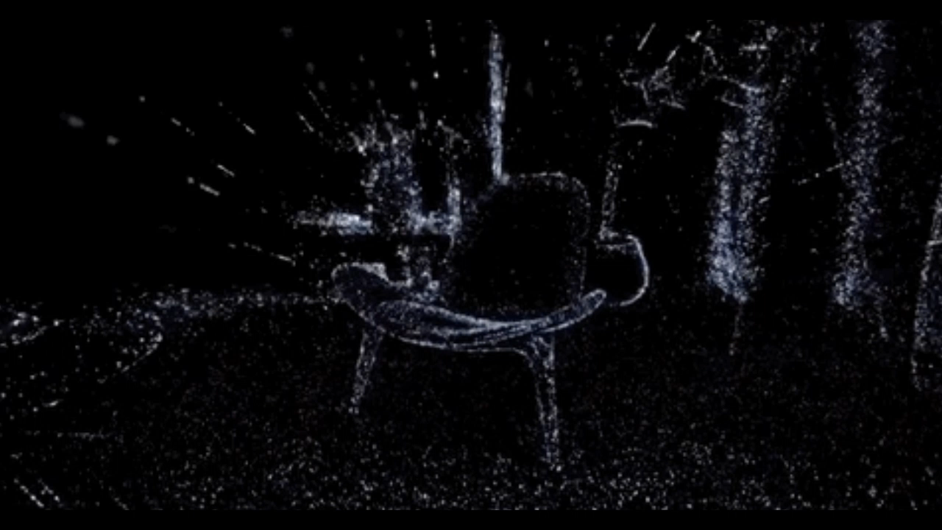
A Photogrammetry scan
A Lidar Scan

Slide 8
Steps Involved
Analyze the data: Techniques such as machine vision analyze this data to make sense of the imagery. AI techniques help identify individual objects in a scene, their movement and interactions with other objects.
Take action: Handheld controllers, motion sensors and speech recognition help users interact with the device and their surrounding environment.
For example, the analysis of collected digital 3D images captured from the physical processes enable a self-driving car to detect a pedestrian in front of it and stop itself in real time. A building control system can adjust the heat or the lights when someone walks into a room in response to their preferences, which are stored in a database.

Slide 9
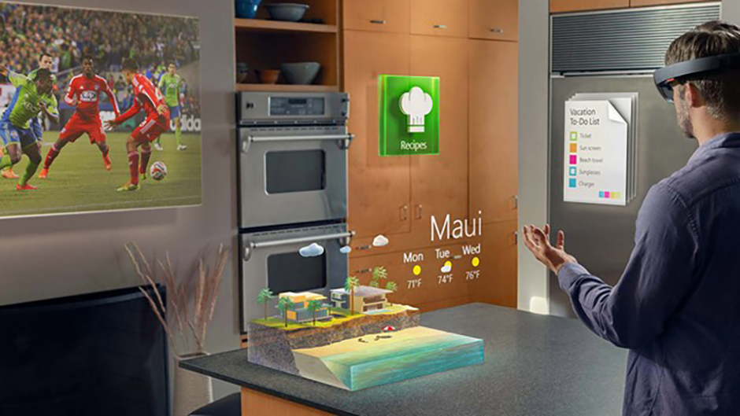
Applications Of Spatial Computing

Slide 10
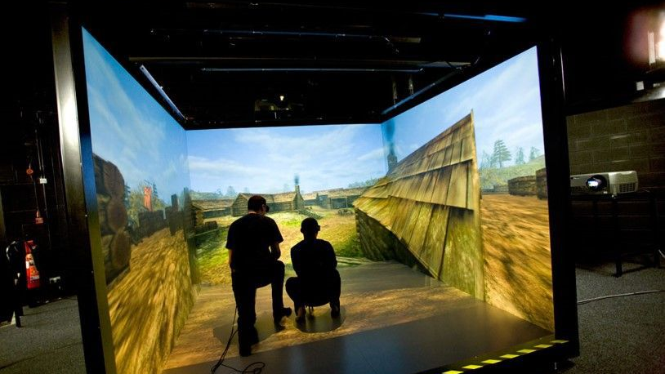
Usage and Impact
Seamless Interaction: Spatial computing brings together digital and physical worlds, enabling users to interact with computers in more seamless and immersive ways. It encompasses concepts like virtual reality (VR) and augmented reality (AR).
Optimization and Automation: Machines equipped with spatial computing technology can learn about physical spaces and human behavior, optimizing and automating processes such as energy-saving in "smart buildings" through data analysis and control signals.
It is also used in other human-computer interactions that leverage real-time spatial positioning for displays, such as projection mapping or cave automatic virtual environment displays.

Slide 11
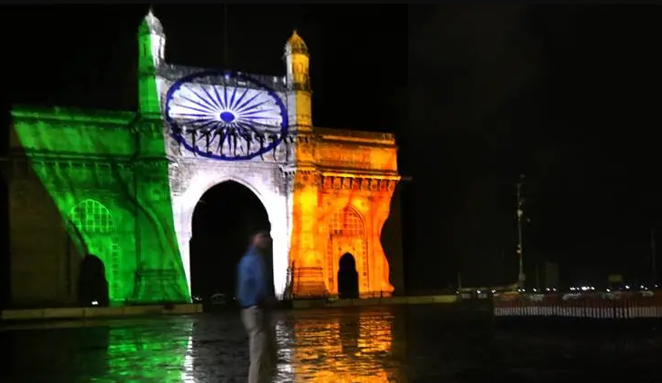
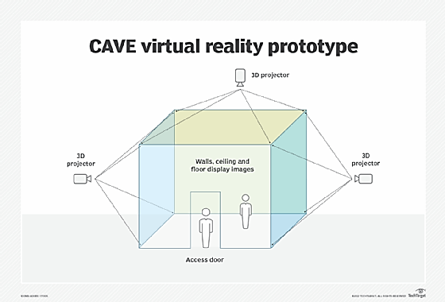
Projection Mapping

Slide 12
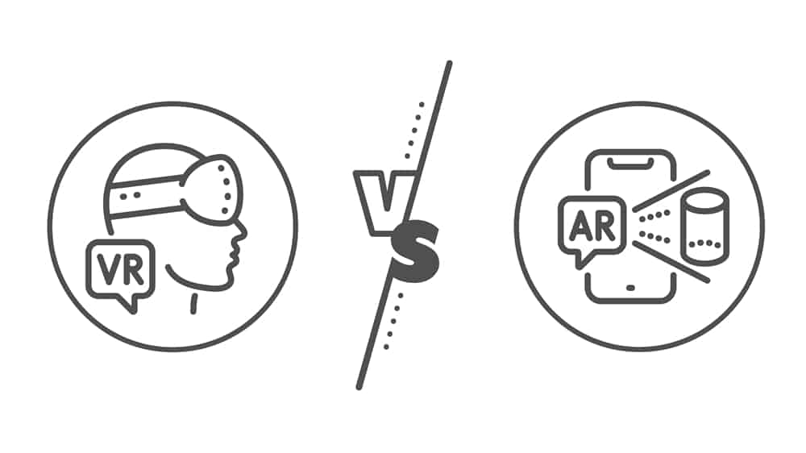
The Differences

Slide 13
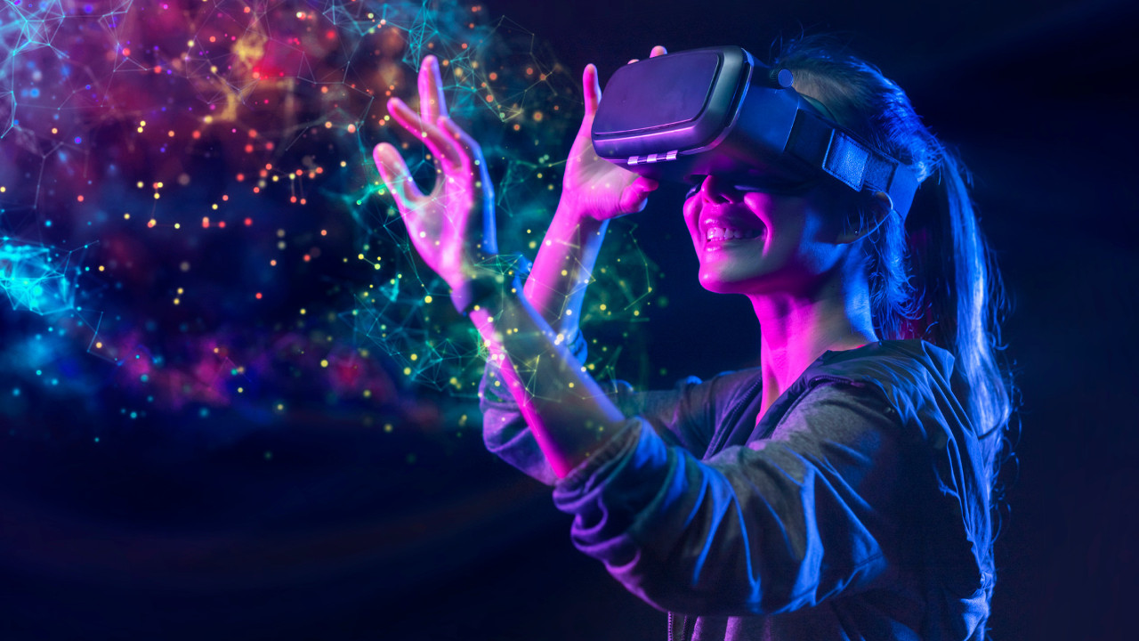
Spatial Computing vs VR and AR
Spatial computing can be used as a general term that extends to technologies such as AR and VR.
VR simulates a 3D environment that lets users explore and interact with a virtual surrounding. The environment is created using computer hardware and software delivered through a wearable headset. AR works similarly, but instead of simulating a different environment, it overlays simulations on top of real-world environments.
While in spatial computing, digital simulations can interact with or appear to modify physical environments.

Slide 14
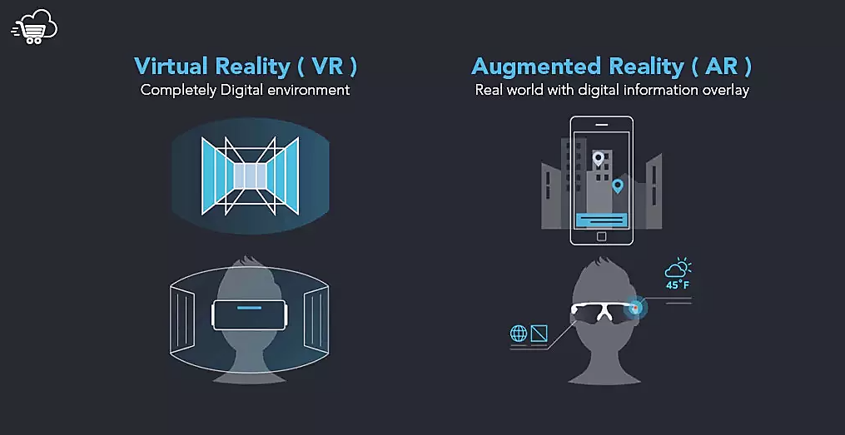
VR vs AR

Slide 15
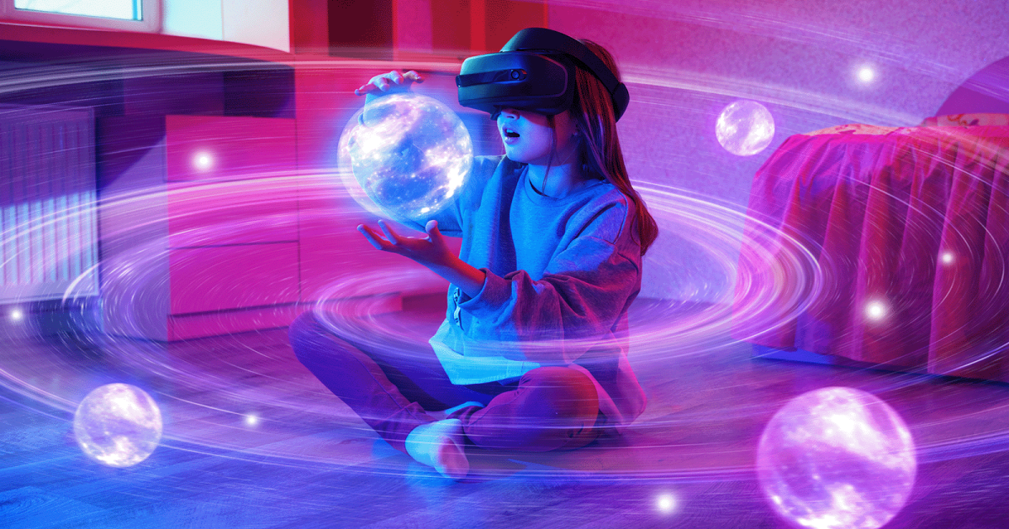
Some Examples

Slide 16
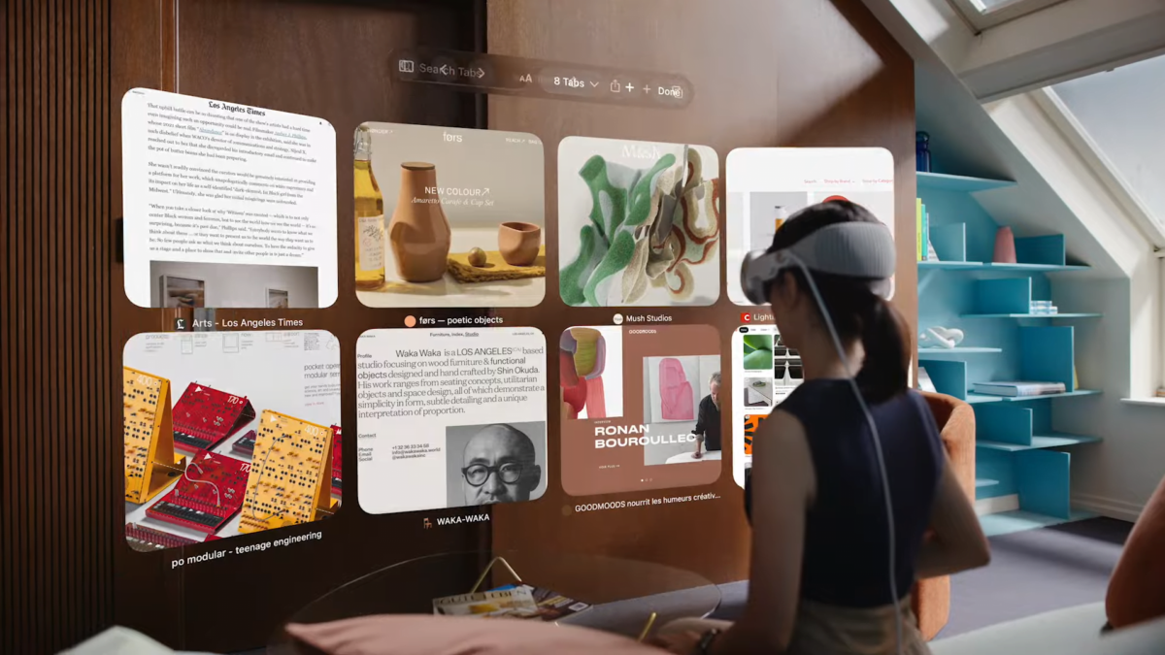
Examples
A mixed reality headset that overlays a repair manual to guide the technician.
A network of cameras that automatically models a car production process.
Offices that dynamically tailor office lighting and environmental controls to individual workers.
Meta Codec Avatars: Virtual Meetings: Meta's spatial computing tools like Meta Workrooms and hyper-realistic codec avatars revolutionize virtual meetings, offering a hyper-realistic experience.
Location Tagging on Social Media Platforms: Tagging locations on social media posts and using GPS-based apps like ridesharing services are everyday examples of spatial computing.

Slide 17
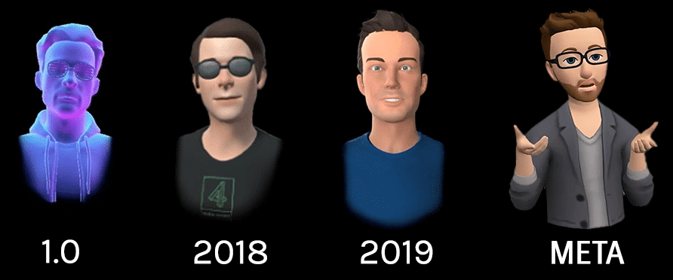
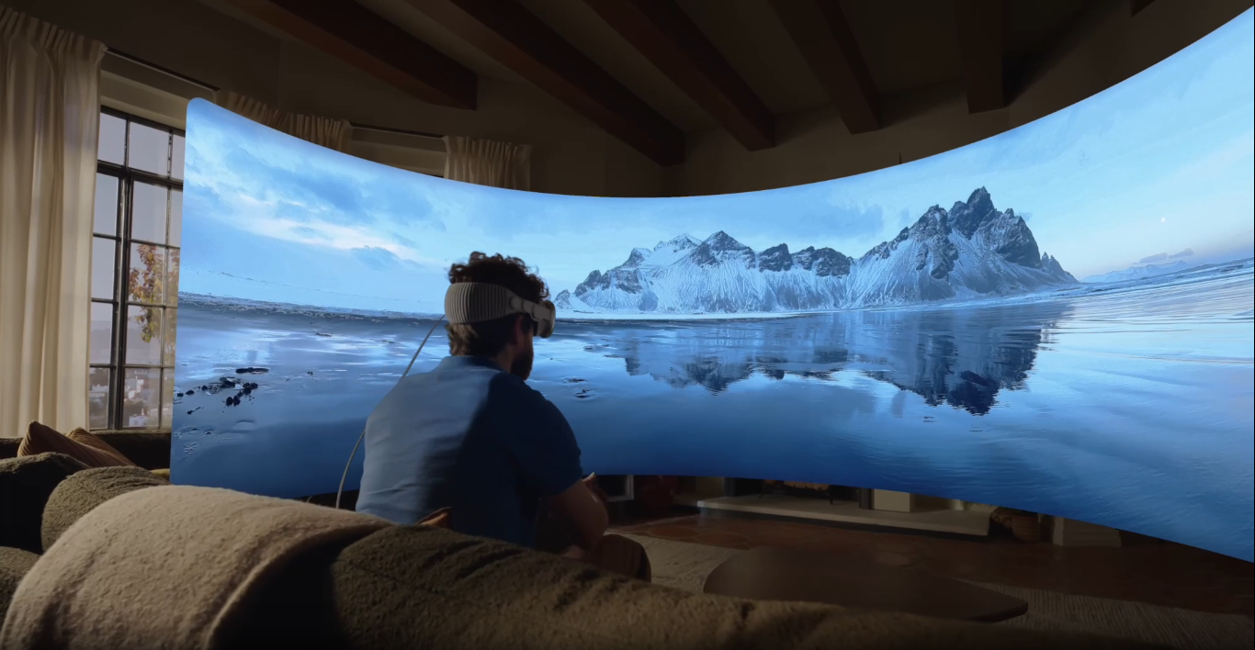
Meta Avatars
Apple Vision Pro

Slide 18
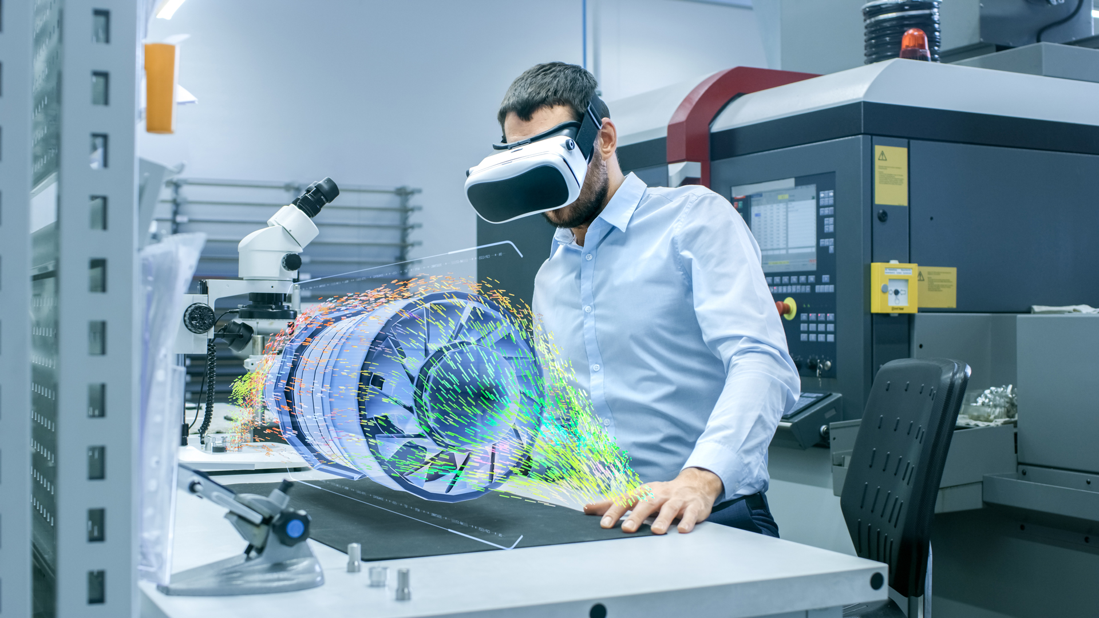
Use Case Scenarios

Slide 19
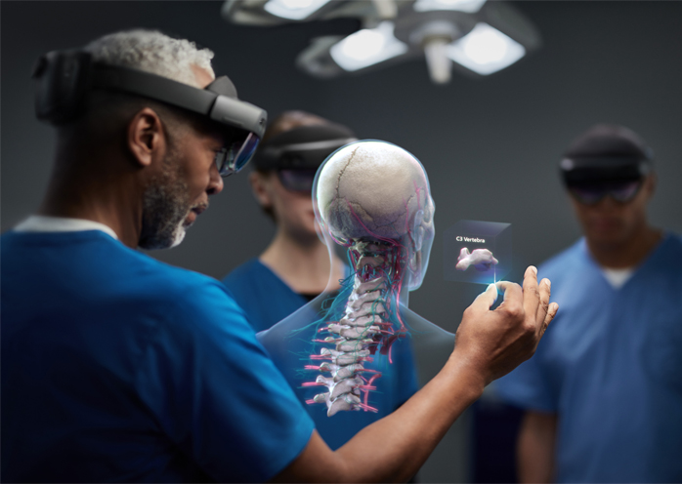
Education And Training
Spatial computing can provide an engaging and interactive learning experience that enhances knowledge retention and skills acquisition.
For example, medical students can use spatial computing to practice surgical procedures in a virtual environment that simulates real-world conditions.
In science and engineering, students can use spatial computing to build and test virtual prototypes of machines or conduct experiments.

Slide 20
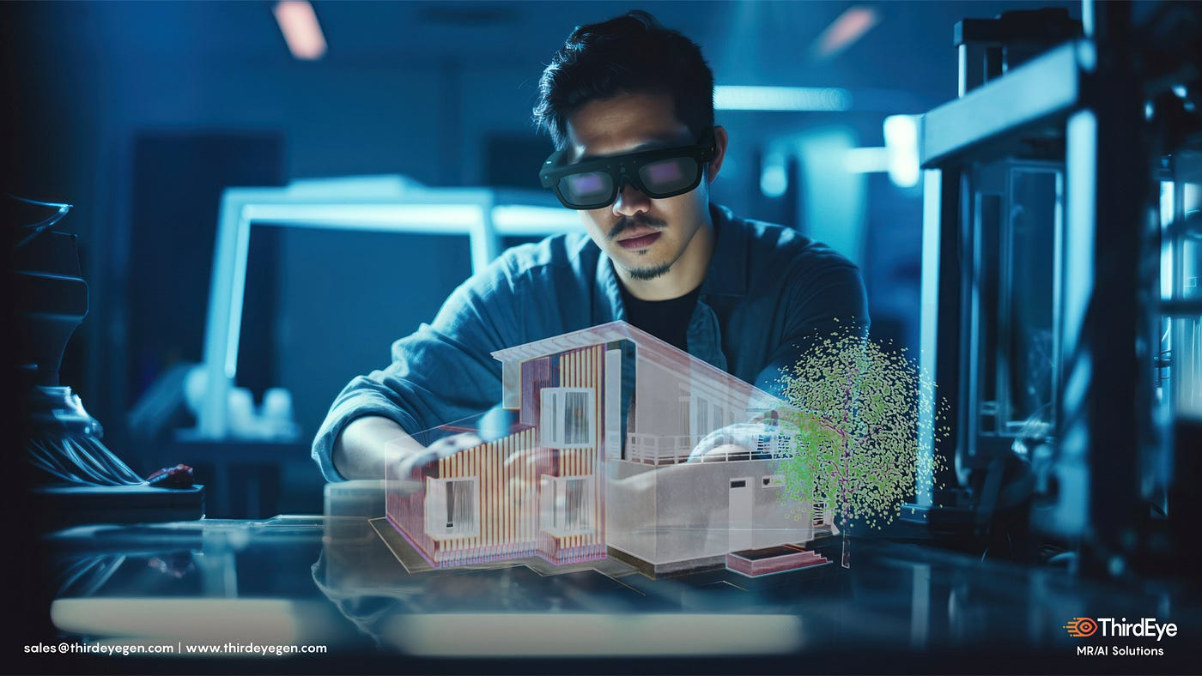
Architecture and Design
Spatial computing can enable architects to create, visualize, and modify designs in the real world without the need for physical prototypes.
This can save time and cost and allow for more iterative design processes.
Designers can also use spatial computing to create virtual prototypes of products and test their functionality and ergonomics in different physical settings

Slide 21
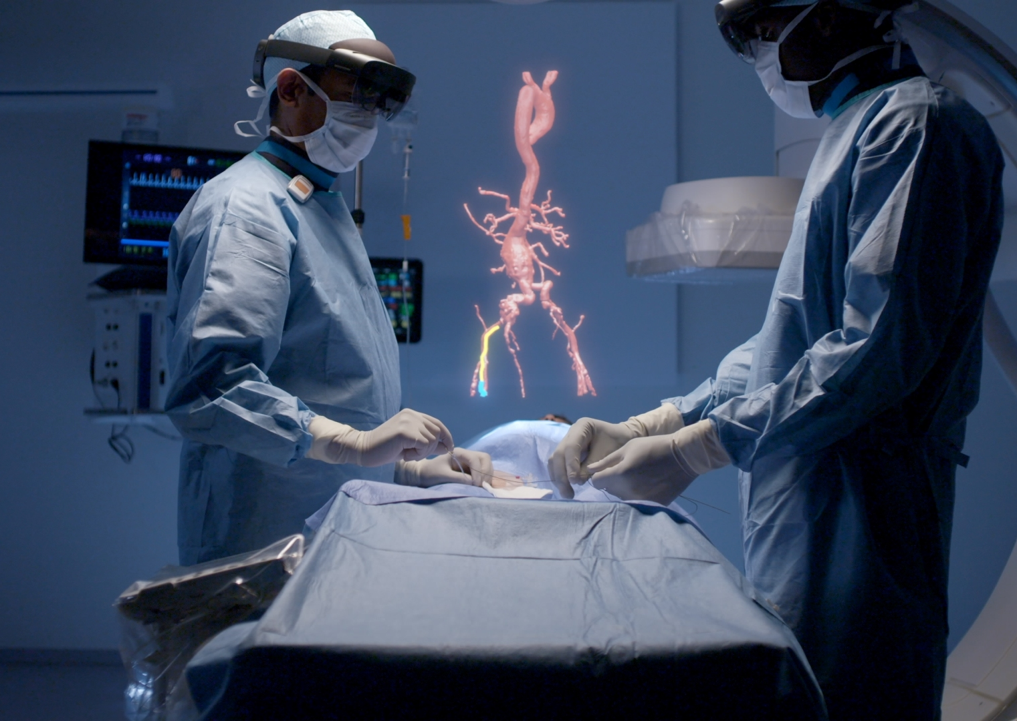
Healthcare
Spatial computing can provide new ways to diagnose, treat, and monitor patients.
For example, doctors could use spatial computing to overlay virtual screens and diagnostic information onto the real world, helping them to make more informed decisions. Or a doctor could see a patient’s medical-imaging scans via a headset while they’re operating on that patient.
Spatial computing could also help patients with physical or cognitive impairments to regain their independence by providing them with virtual assistants or rehabilitation exercises that are tailored to their needs.

Slide 22
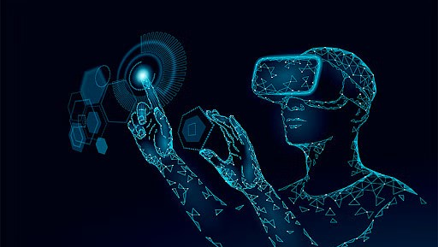
Challenges

Slide 23
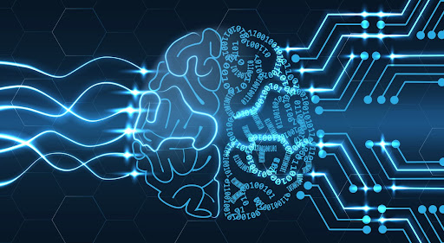
Hurdles to be Crossed
Despite its appeal, spatial computing has had mixed success so far. One of the biggest challenges facing the field is the cost of hardware. The best spatial-computing devices cost thousands of dollars and are not accessible to everyone.
In addition, the weight of the headsets, low resolution, and lack of comfort have been major concerns, as they can cause fatigue and motion sickness during extended use. Battery life is also a limiting factor: Most devices' batteries last just a few hours and require frequent charging.
But companies are making progress in many of these areas. And as other industries have shown, the cost of sensors, displays, and hardware will gradually decrease as the field evolves and becomes more competitive.
As spatial computing evolves, it will face challenges related to privacy, data security, and hardware and software reliability.

Slide 24
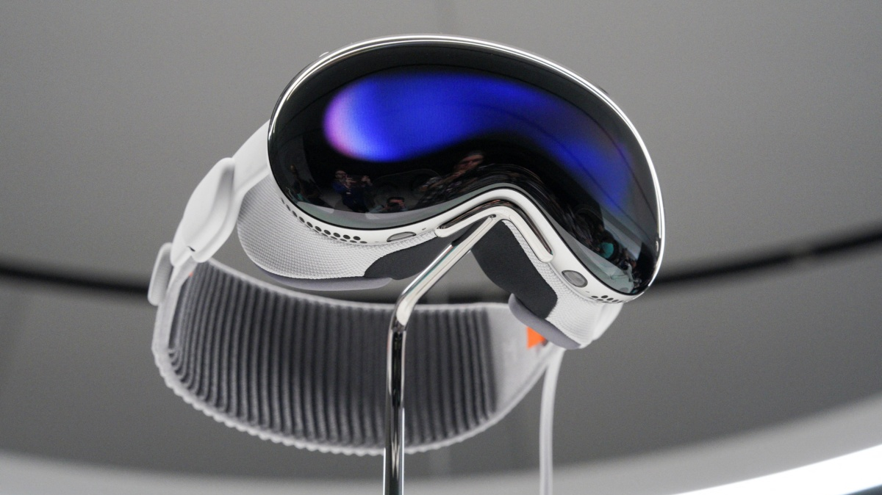
Recent Advancements
However, these technologies have made more recent advancements, which makes the experience more practical.
For example, the Apple Vision Pro, which some claim has the potential to revolutionize spatial computing, can fit a number of sensors. This makes the experience of moving around with it and using hand gestures smoother and more responsive.
Apple Vision Pro uses two main cameras, four downward-facing cameras, two infrared cameras, two TrueDepth cameras, two side cameras and five other sensors.

Slide 25
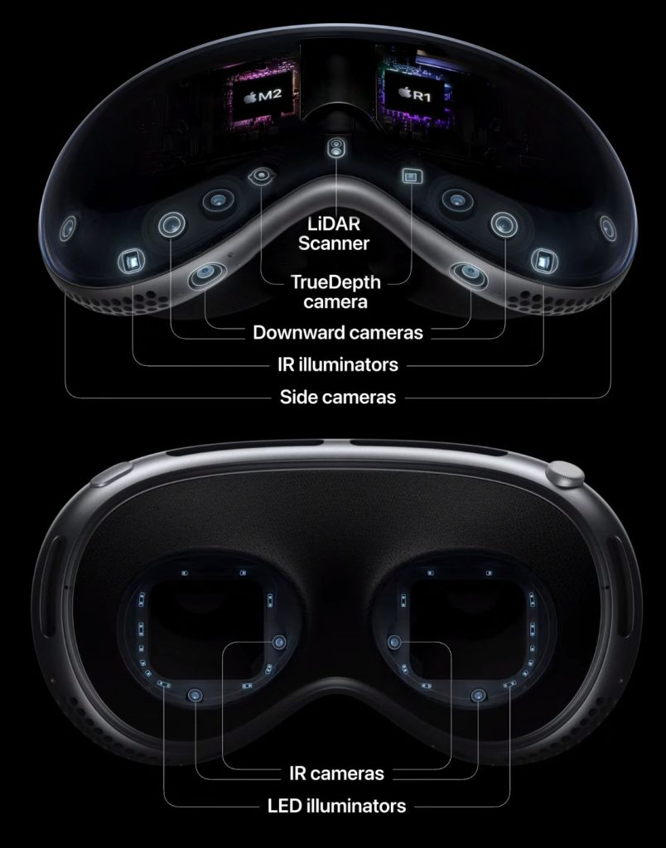
Inside Apple Vision Pro

Slide 26
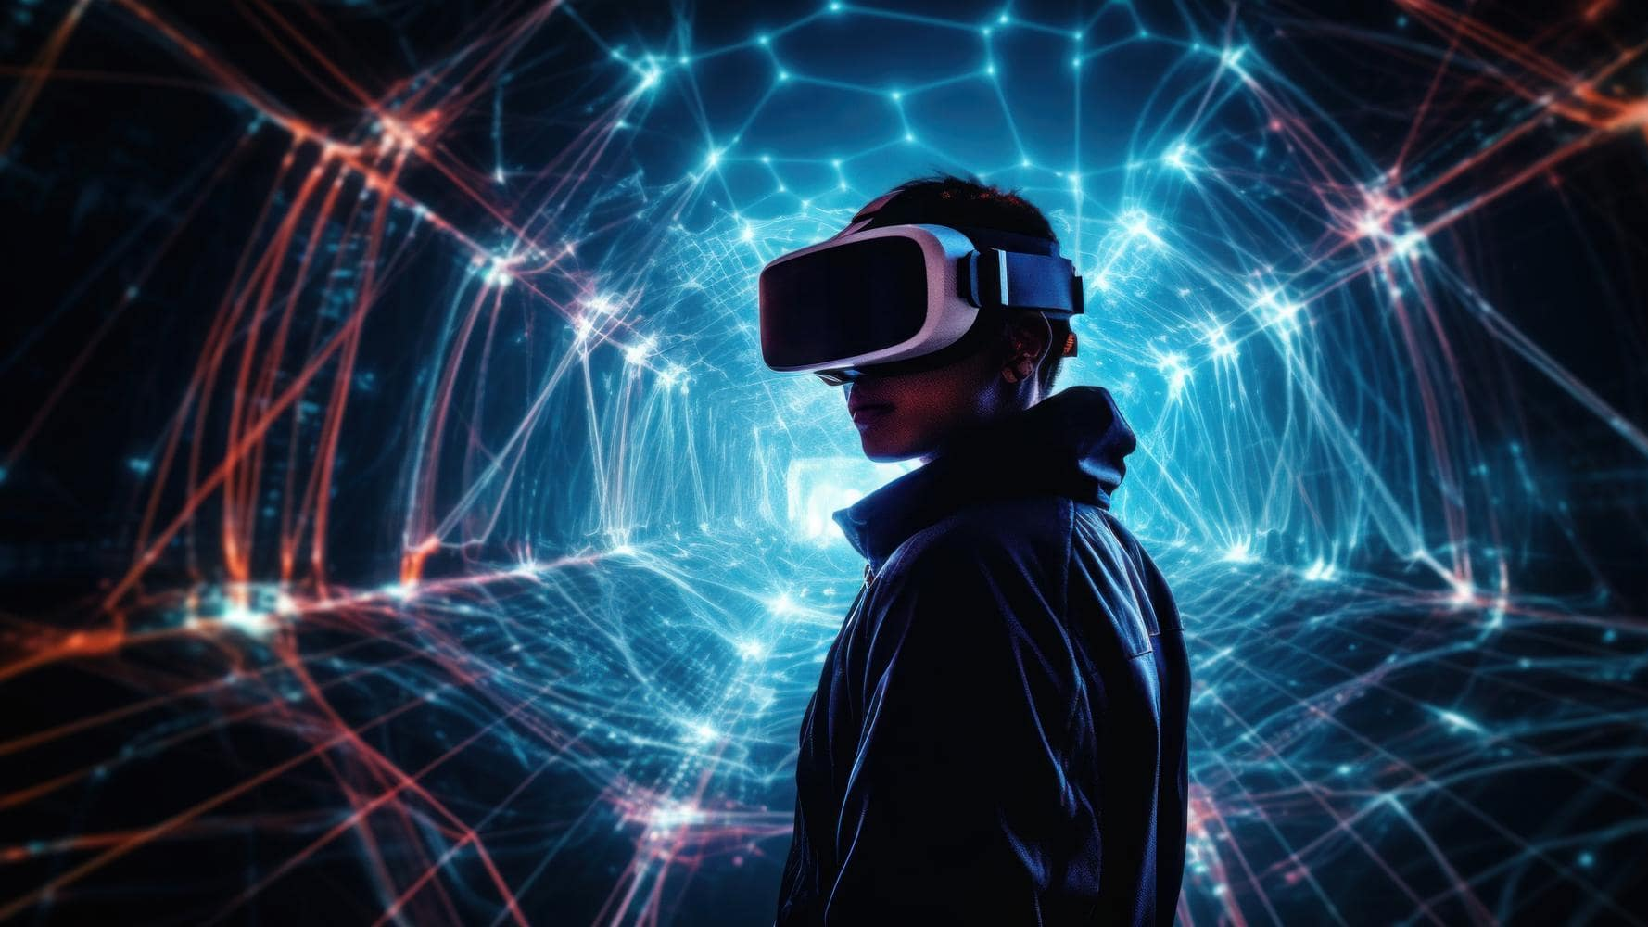
Future of Spatial Computing

Slide 27
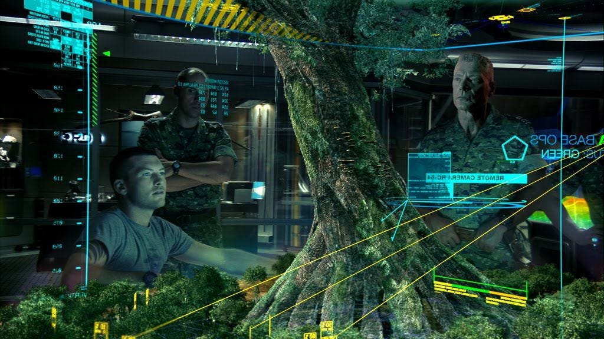
Future Hindsight
Spatial computing, expected to reach a market size of over $700 billion by 2033, integrates AI, computer vision, AR, and VR to merge virtual experiences with the physical world. Many believe that it has the potential to impact the world in the same way smartphones did in the early 2000s.
This can also be viewed as a shift from personal computing (the Mac) to mobile computing (the iPhone) and now into spatial computing (the Apple Vision Pro).
Spatial computing is expected to enhance human-machine and machine-machine interactions in various sectors such as industry, healthcare, transportation, and home automation, with major companies heavily investing in the technology.

Slide 28
Thank You

